Slide 1
Consumer Behavior
In Conventional Marketing

Slide 2
Arguing with stupid people is like killing the mosquito on your cheek. You might or might not kill it, but you will end up slapping yourself.

Slide 3
Consumer Buyer Behavior
Consumer market refers to the group of individuals or households who purchase goods and services for personal consumption. It is a broad market segment that encompasses a wide range of products and services designed for individual use rather than for resale or industrial purposes.
Consumer buyer behavior refers to the buying behavior of final consumers—individuals and households who buy goods and services for personal consumption

Slide 4
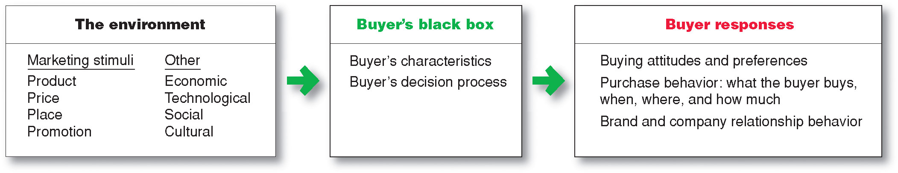
Model of Consumer Behavior

Slide 5
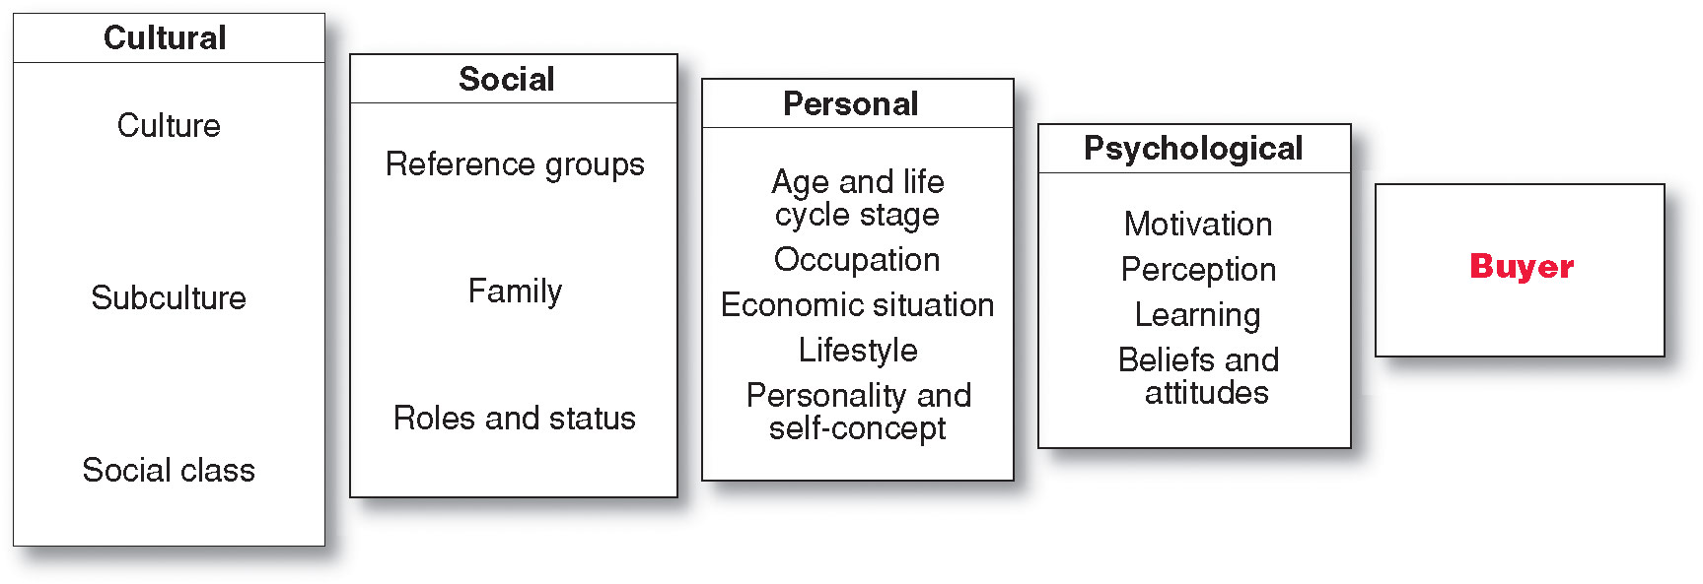
Characteristics Affecting Consumer Behavior

Slide 6
Cultural Factors
Culture is the learned values, perceptions, wants, and behavior from family and other important institutions
Subcultures are groups of people within a culture with shared value systems based on common life experiences and situations
Bengalis
Gujaratis
Punjabis

Slide 7
Continue…
Social classes are society’s relatively permanent and ordered divisions whose members share similar values, interests, and behaviors
Measured by a combination of occupation, income, education, wealth, and other variables

Slide 8
Social Factors
Membership Groups are the groups with direct influence and to which a person belongs.
Reference Groups are the groups that form a comparison or reference in forming attitudes or behavior.
Aspirational Groups are the groups an individual wishes to belong to.

Slide 9
Continued…
Groups and Social Networks
Word-of-mouth influence and buzz marketing
Opinion leaders are people within a reference group who exert social influence on others
Also called influentials or leading adopters
Marketers identify them to use as brand ambassadors

Slide 10
Continued…
Online Social Networks are online communities where people socialize or exchange information and opinions
Include blogs, social networking sites (facebook), virtual worlds (second life)

Slide 11
Continued…
Family is the most important consumer-buying organization in society
The groups, family, clubs, and organizations that a person belongs to define his/her social role and status

Slide 12
Personal Factors
Age and life-cycle stage
RBC Royal Bank stages
Youth: younger than 18
Getting started: 18–35
Builders: 35–50
Accumulators: 50–60
Preservers: over 60

Slide 13
Continued…
Occupation affects the goods and services bought by consumers
Economic situation includes trends in:
Personal income
Savings
Interest rates

Slide 14
Continued…
Lifestyle is a person’s pattern of living as expressed in his or her psychographics
Measures a consumer’s AIOs (activities, interests, opinions) to capture information about a person’s pattern of acting and interacting in the environment

Slide 15
Psychological Factors
Motivation
Perception
Learning
Beliefs and attitudes

Slide 16
Continued…
Motivation: The internal needs and desires that drive consumers to make a purchase. For instance, a person might be motivated to buy a smartphone because they desire the latest technology and features.

Slide 17
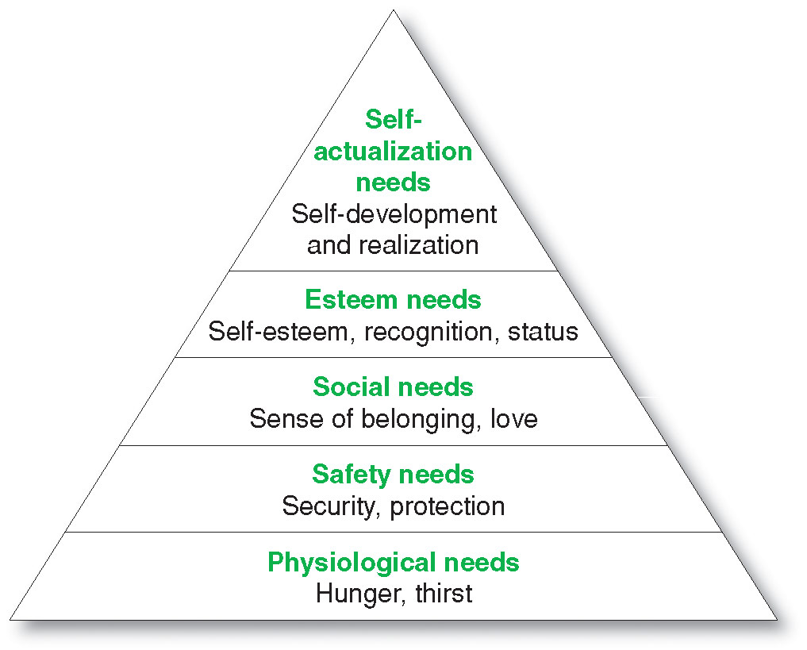
Motivation (Maslow’s Hierarchy of Needs)

Slide 18
Continued…
Perception is the process by which people select, organize, and interpret information to form a meaningful picture of the world from three perceptual processes
Selective attention
Selective distortion
Selective retention

Slide 19
Continued…
Selective attention is the tendency for people to screen out most of the information to which they are exposed
Selective distortion is the tendency for people to interpret information in a way that will support what they already believe
Selective retention is the tendency to remember good points made about a brand they favor and forget good points about competing brands

Slide 20
Continued…
How consumers perceive a product or brand can influence their purchasing decisions. For example, a consumer may perceive a luxury car brand as being of higher quality and prestige, leading them to choose it over a less expensive option.

Slide 21
Continued…
Learning is the change in an individual’s behavior arising from experience and occurs through interplay of:
Drives
Stimuli
Cues
Responses
Reinforcement

Slide 22
Continued…
Belief is a descriptive thought that a person has about something based on:
Knowledge
Opinion
Faith
Attitudes describe a person’s relatively consistent evaluations, feelings, and tendencies toward an object or idea

Slide 23


Slide 24
Types of Buying Decision Behavior
Complex buying behavior
Dissonance-reducing buying behavior
Habitual buying behavior
Variety-seeking buying behavior

Slide 25
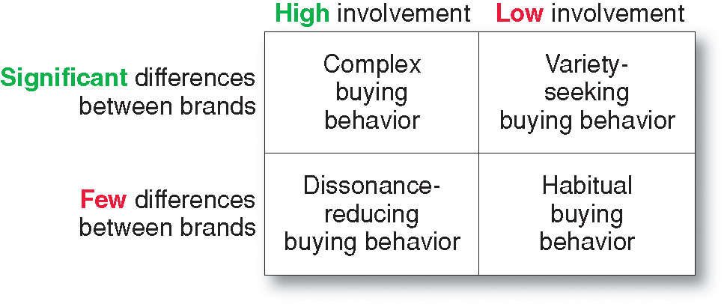
Continued…

Slide 26
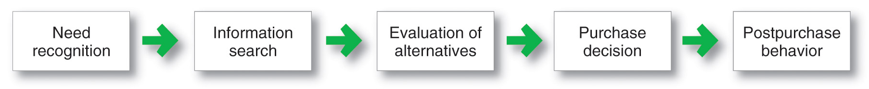
The Buyer Decision Making Process

Slide 27
Need Recognition
Occurs when the buyer recognizes a problem or need triggered by:
Internal stimuli
External stimuli

Slide 28
Information Search Sources of Information
Personal sources—family and friends
Commercial sources—advertising, Internet
Public sources—mass media, consumer organizations
Experiential sources—handling, examining, using the product

Slide 29
Evaluation of Alternatives
How the consumer processes information to arrive at brand choices

Slide 30
Purchase Decision
The act by the consumer to buy the most preferred brand
The purchase decision can be affected by:
Attitudes of others
Unexpected situational factors

Slide 31
Post-Purchase Decision
The satisfaction or dissatisfaction that the consumer feels about the purchase
Relationship between:
Consumer’s expectations
Product’s perceived performance
The larger the gap between expectation and performance, the greater the consumer’s dissatisfaction
Cognitive dissonance is the discomfort caused by a post-purchase conflict

Slide 32
The Buyer Decision Process for New Products
Adoption process is the mental process an individual goes through from first learning about an innovation to final regular use.
Stages in the process include:
Awareness
Interest
Evaluation
Trial
Adoption

Slide 33
Influence of Product Characteristics on Rate of Adoption
Relative advantage (degree to which innovation appears superior to existing product)
Compatibility (degree to which the innovation fits the values & experiences of potential Consumer)
Complexity (degree to which an innovation is difficult to understand)
Divisibility (degree to which innovation may be tried on a limited basis)
Communicability (degree to which the results of using the innovation can be observed or described to others)

Slide 34
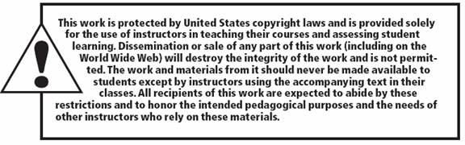
All rights reserved. No part of this publication may be reproduced, stored in a retrieval system, or transmitted, in any form or by any means, electronic, mechanical, photocopying, recording, or otherwise, without the prior written permission of the publisher. Printed in the United States of America.
Copyright © 2010 Pearson Education, Inc.
Publishing as Prentice Hall

